Slide 1
Cognition and Perception
Charlotte Price
Highly Specialist Physiotherapist
Neuro Rehabilitation
Guest Lecturer
Notes:
15.00-17.00
Roles

Slide 2
Learning outcomes
Explain the role of cognition and perception in functional movement and rehabilitation outcomes.
Identify common cognitive impairments (e.g., attention, memory, executive function) and perceptual deficits (e.g., neglect, apraxia, agnosia) in neurological populations.
Select and justify appropriate assessment tools to evaluate cognition and perception in clinical practice.
Discuss physiotherapy strategies to address cognitive and perceptual problems in rehabilitation.
Integrate cognitive and perceptual considerations into patient assessment and treatment planning.

Slide 3
Perception is the term used to refer to the processes involved in making sense of the senses; the way in which we interpret the information gathered and processed by the senses.
Cognition is the ability to perceive, represent and organise objects, events and their relationship to one another in an appropriate way. It comprises all the mental processes that allow us to attend to, recognise, learn and remember changing information in the environment.
Notes:
The early stages of processing is the processing of sensory information called perception
Organises sensory information recieved by vision, sound, touch and pain picked up by our bodies

Slide 4
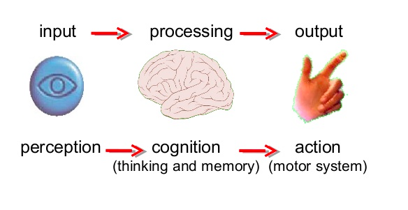

Slide 5

Goal orientated activity
perception
Find the number
memory
Remember it long enough to dial it
Produce and understand spoken words
motor planning
sustained attention
Notes:
Making a telephone call
UL muscles lift and hold the phone, trunk muscles stablise the trunk and larynx produces the sppech sound.
? Cognitive and perpetual demands.

Slide 6
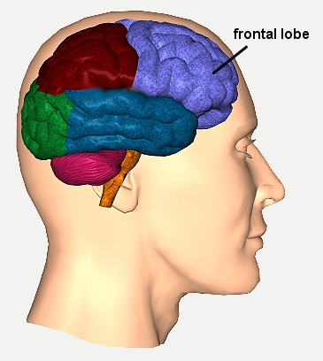
Frontal lobe
Attention
Higher level cognitive function
Memory
Notes:
Patients can have problems based on the size and location of the lesion but….. You also need to factor in the the brain functions as a whole system and these areas all interact with other areas.
Integration and co-ordination of different areas of the brain
Abstract thought
Judgement
Ethics
Insight
Emotion
Tact
Inhibition
Sequencing
Evaluation
Problem solving

Slide 7
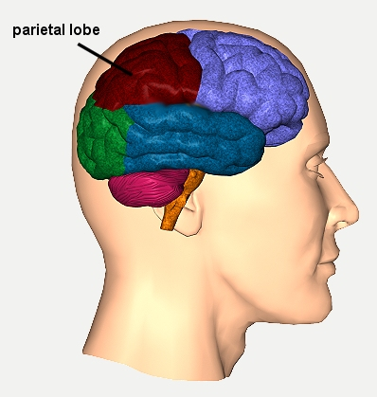
Parietal lobe
Interpretation of sensory input
Contralateral sensation weight, pressure, pain, etc.
Spatial recognition “where” processing
Notes:
Pathway from occipital love projects to the parietal love for processing of spatial recogtnion

Slide 8
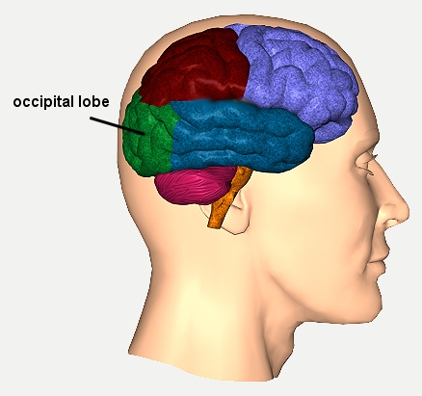
Occipital lobe
Primary visual area
Analyses colour, form, location, motion

Slide 9
Temporal lobe
Auditory and olfactory area
Detailed memories
Wernicke’s area
Processes visual information of objects “what”
Temporal

Slide 10
Hierarchy of cognition
Executive
Function
Praxis
Memory
Visual/spatial perception
Attention
Sensory Registration
Object recognition
Notes:
The hierarchy of cognition describes how complex cognitive abilities are built upon simpler ones, often visualized as a pyramid with foundational skills at the bottom and higher-order skills at the top. Foundational elements like processing speed, attention, and sensory input are at the base, which support more complex functions such as working memory, executive function, and language. This structure explains how weaknesses at a foundational level can impact higher-level thinking and problem-solving.

Slide 11
Executive
Function
Praxis
Memory
Visual/spatial perception
Attention
Sensory Registration
Object recognition

Slide 12
Sensory registration
Information reaches the nervous system from the sense organs: sight, hearing, touch, smell, taste (proprioception)
External physical stimuli are converted to a form that the nervous system can use – coding/registration
Vision is the dominant sense in cognition
Visual assessment:
  Visual acuity (normally wear glasses)
  Tracking and scanning
  Visual fields: confrontation test
Notes:
The initial stage of cognitive processing where the brain detects and records sensory input (visual, auditory, tactile, proprioceptive, vestibular, etc.) from the environment and body.
It occurs automatically and rapidly, often below conscious awareness.
Sensory information is held briefly (milliseconds to seconds) in sensory memory before being filtered for relevance.
Purpose: To provide raw data for further processing (attention and perception).
🔹 Example:
When a physiotherapist touches a patient’s arm, the skin and proprioceptors detect the stimulus — this sensory input must be registered before the patient can attend to it or move purposefully.

Slide 13
Executive
Function
Praxis
Memory
Visual/spatial perception
Attention
Sensory Registration
Object recognition

Slide 14
Attention
Attention is a basic part of processing- prerequisites include alertness and arousal
Focuses cognitive resources on selected stimuli from sensory registration.
Attention is affected by internal (fatigue, thirst) and external influences (temperature), individual differences and by task novelty (new tasks increase attentional demands)
Notes:
Focuses cognitive resources on selected stimuli from sensory registration.
Filters out irrelevant information (e.g., background noise).
Foundation for all conscious learning and motor control.
🔹 Clinical relevance: A patient with impaired attention may not engage safely in balance or gait tasks.

Slide 15
Type of Attention | Description | Example in Physiotherapy
Focused | Respond to specific stimuli | Reacting to verbal/tactile cue
Sustained | Maintain attention over time | Staying on task during exercises
Selective | Filter distractions | Focusing in busy rehab gym
Alternating | Switch attention between tasks | Listening then performing
Divided | Do two tasks at once | Walking + talking

Slide 16
Executive
Function
Praxis
Memory
Visual/spatial perception
Attention
Sensory Registration
Object recognition

Slide 17
Visual and spatial perception
Complex mechanism in which sensory information is given meaning through association with our stored knowledge
Divided into visual perception and visuospatial perception
  Visuoperceptive skills include colour perception, depth perception and figure ground perception (What things are)
  Visuospatial perception skills includes the ability to appreciate the spatial relationships between objects and landmarks (Where things are)
Notes:
The brain interprets sensory input into meaningful information (“what” and “where”).
Integrates multiple sensory modalities.
🔹 Example: Recognising an object as a cup or understanding spatial orientation for reaching.

Slide 18
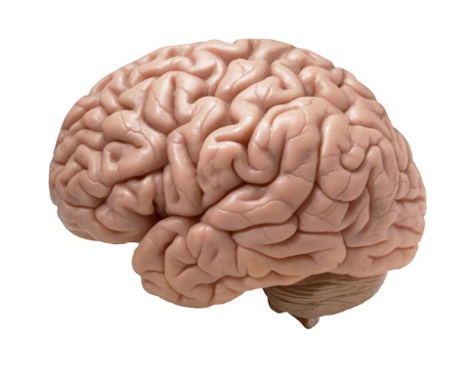
Visual and spatial perception
Visuo-spatial perception
(parietal lobe – Right dominant)
Primary and
secondary
visual areas
visual perception
(temporal lobe)
Notes:
Right-sided parietal lesions lead to neglect more frequently because the right hemisphere's parietal lobe is responsible for attention to both the left and right sides of space, while the left hemisphere's parietal lobe primarily attends only to the right. When the right parietal lobe is damaged, there is no strong compensatory mechanism in the left hemisphere to attend to the left side, resulting in a more severe and persistent neglect of the left side of space.

Slide 19
Executive
Function
Praxis
Memory
Visual/spatial perception
Attention
Sensory Registration
Object recognition

Slide 20
Object recognition
Object recognition integrates basic perception with stored knowledge of objects and their use
Memory
Object Recognition
Visual/Spatial Perception

Slide 21
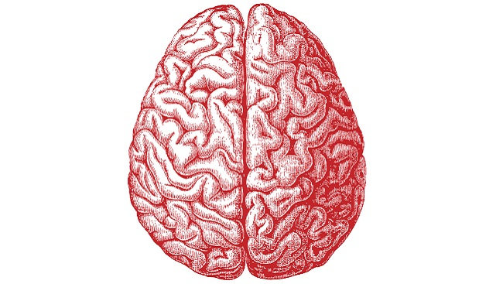
Object recognition
associative recognition
(L temporal)
perceptual recognition
(R parietal/temporal)
Notes:
Associative recognition is calling upon previously encountered memories to recognise them.
The percept is compared with stored representations in memory (“this is a cup”)
So the brain is able to perceive the image or situation and aware there is something to perceive, but then we need to interpret what we are perceiving. This is recognition, and the brain puts what we see into categories, ie. See a duck on a pond etc.
Recognise objects but not name them if Lt damage

Slide 22
Executive
Function
Praxis
Memory
Visual/spatial perception
Attention
Sensory Registration
Object recognition

Slide 23
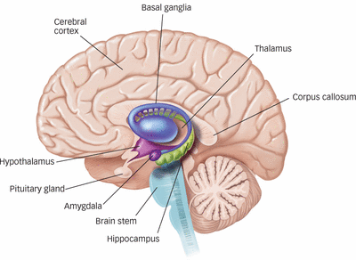
Memory
Notes:
(basal ganglia, thalamus, basal forebrain, hippocampus, non-medial temporal lobes, regions of frontal lobes)

Slide 24
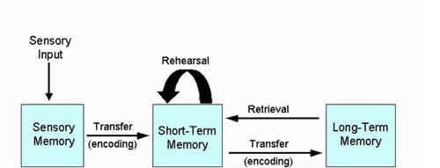
Memory
Memory allows us to retain and recall information on all aspects of daily life.
Stores and retrieves information from experience.
Short-term (working memory): holds active task information (e.g., remembering movement sequence).
Long-term: consolidates learning and skills.
3 stages of memory
- encoding (transfer stimulus into a code that the brain accepts)
- storage (retaining information)
retrieval (recall or recognition: accessing stored information)
Notes:
Memory allows us to retain and recall information on all aspects of daily life.
3 stages of memory
- encoding (transfer stimulus into a code that the brain accepts)
- storage (retaining information)
retrieval (recall or recognition: accessing stored information)
Wokring memoery, here and now. Not longer called short term memory
Working Memory
information is held for a short period of time
a temporary working store e.g. memorise a phone number and then call
Long term memory represents the permanent store of information
memories may decay if not retrieved frequently

Slide 25
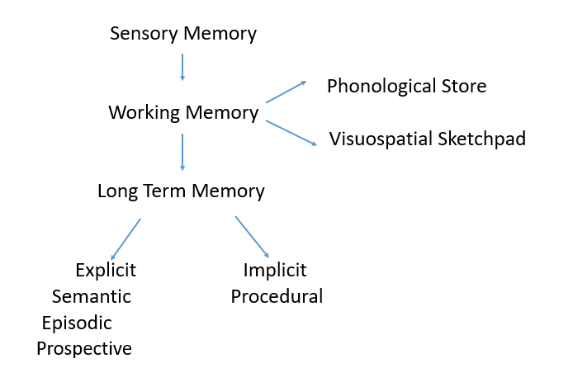
Memory
Notes:
Sensory memory ( Sensory registration) allows us to attend to relevant information and transfer to STM, If not used the info is discarded
Phonological store is holding words (speech) or numbers, used a lot in spelling and writing/reading
Visuospatial sketchpad – for giving directions, rotating 3d shape in head, drawing from memory etc.
LTM:
Semantic: knowledge and facts
Episodic memory: past events and activites
Prospective: remembering to do things in the future
Procedural: learned motor cognitive or language processes ie. Motor skills, riding bike etc

Slide 26
Executive
Function
Praxis
Memory
Visual/spatial perception
Attention
Sensory Registration
Object recognition

Slide 27
Praxis
Praxis refers to the ability to use our hands and body in skilled/previously learned tasks in order to function
Praxis involves three component systems (which can be selectively impaired with neurological damage)
Notes:
Praxis is the ability to plan, organise, and carry out purposeful, skilled movement — even when there is no weakness, sensory loss, or incoordination.
It’s what allows someone to use tools, perform gestures, and sequence complex motor actions automatically (like making tea or brushing teeth).
👉 In short: Praxis = motor planning — knowing what to do, how to do it, and in what order.

Slide 28
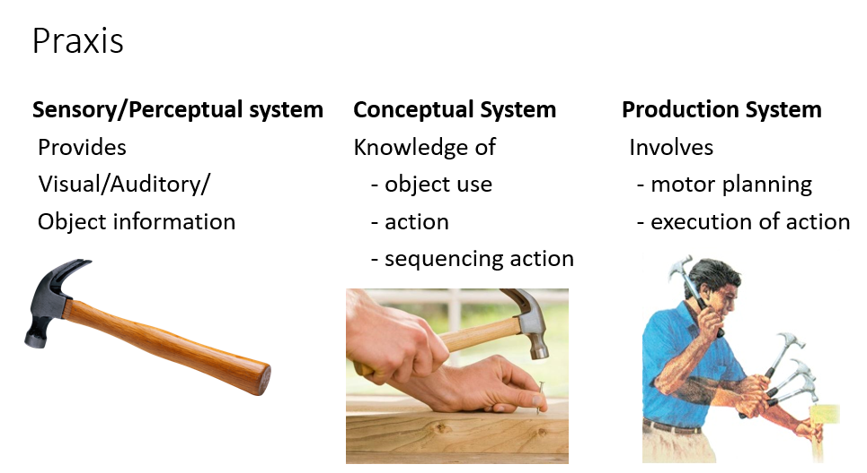
Stage | Description | Example
1️⃣ Ideation | Concept of the movement or task | Knowing that a toothbrush is used to clean teeth
2️⃣ Planning (Ideomotor stage) | Selecting and sequencing appropriate motor actions | Planning the steps — pick up brush, apply toothpaste, move arm to mouth
3️⃣ Execution | Carrying out the planned movement | Physically performing the brushing action
Notes:
Motor planning (force, direction, time of action)
Praxis contain perceptual, sensory and motor components of a movement and become established with practice
So they are a scheme of movements which can be translated to everyday lives ie. Reach to grasp

Slide 29
Executive
Function
Praxis
Memory
Visual/spatial perception
Attention
Sensory Registration
Object recognition

Slide 30
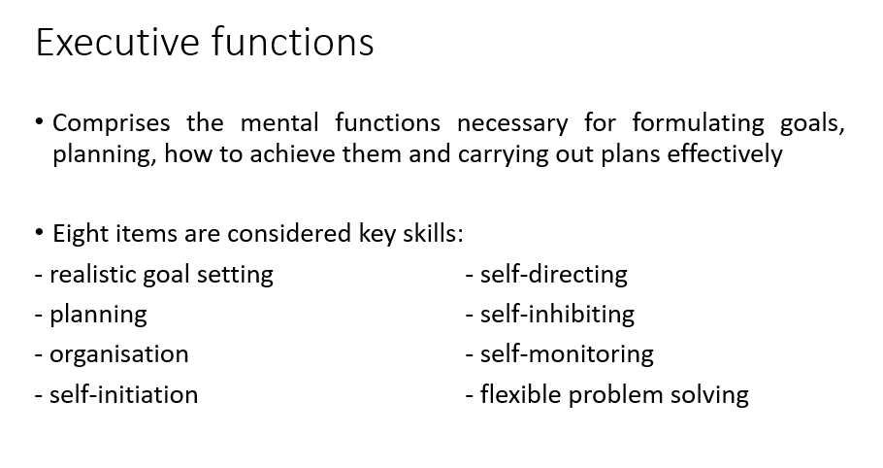

Slide 31
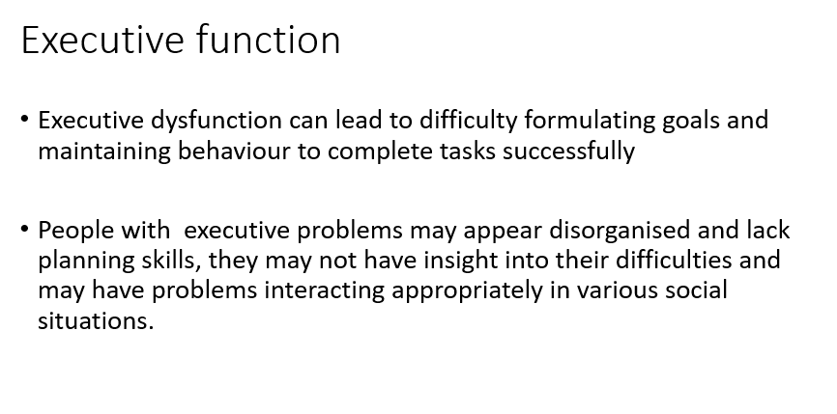

Slide 32
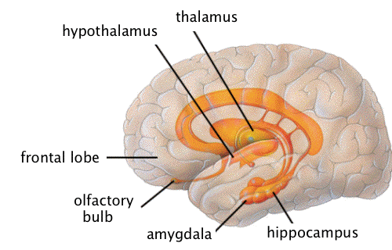
Limbic system
Executive function
Emotion
Notes:
Thalamus
Hypothalamus snd hippocampus- all arch over the corpus callosum which is a mass nerve fibres linking the right and left part of the brain and together with pre- frontal cortex – play in an important part in executive functions for planning and monitoring behaviour

Slide 33
Visual and Spatial Perception
The ability to accurately perceive relationships of objects and oneself in space.
Visual perception gives meaning to all information entering our eyes.
It’s NOT a problem with vision, but the interpretation of the visual information

Slide 34
Three areas of visual and spatial perceptual impairments
Body scheme disorder | Knowledge and representation of body parts in relation to each other and within space.
Visual discrimination | The ability to recognise details in visual images – colour, shape, form, depth, size of objects, people etc.
Object recognition | Ability to interpret visual information to recognise objects, people etc.

Slide 35
Visual and Spatial Perception
parietal lobe
temporal lobe

Slide 36
Neglect/Inattention
A body scheme disorder
An attention deficit but to one side of space/ body part. More common on left side, i.e. with right sided lesion.
Patient may fail to respond to objects or stimuli on their affected side. May be visual, sensory, or both.

Slide 37
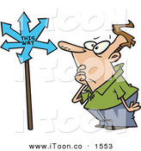
Topographical disorientation
(occipital, temporal, parietal lobes)
Inability to find your way in space.
Multiple visual discrimination skills required; distance of objects, colour, shape, form.
Patients may not be able to navigate within familiar environments or on new routes that they have practiced multiple times.

Slide 38
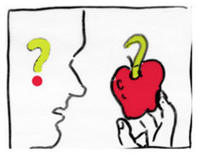
Agnosia (occipital, parietal lobes)
The inability to identify an object.
Can be only certain objects e.g faces
Can be broad e.g. various everyday objects.
May struggle with functional tasks because they do not recognise the tools they have or their use.
Notes:
Different types of agnosia

Slide 39
Common cognitive impairments in neuro populations
Attention
Memory
Speed of processing
Executive function (high level skills)
Apraxia

Slide 40
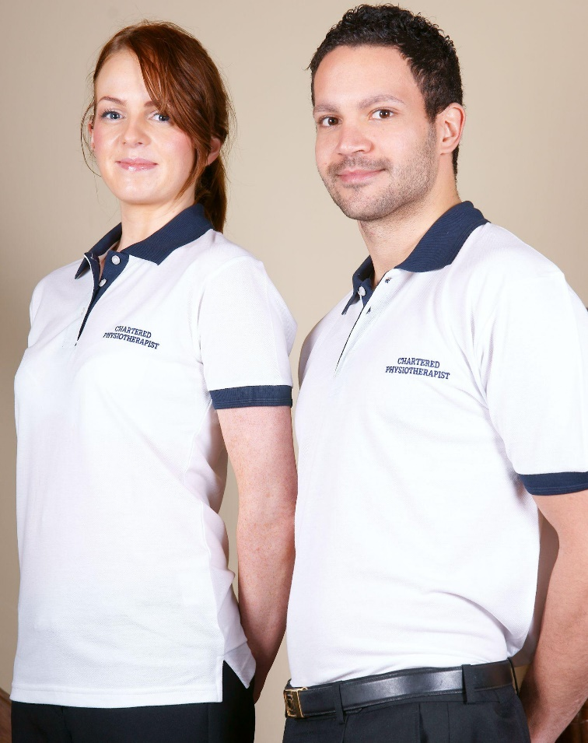
What do you think the physiotherapist’s role in the assessment and rehab of cognition?
What problems may affect your physiotherapy session?

Slide 41

MDT working and cognition
Psychology
Psychometric assessments
Evaluate mood
Physiotherapy
Physical restoration
Doctors
Diagnostics
Occupational Therapy
Assess impact on occupational performance
Nursing
Care

Slide 42
How do you assess cognitive and visual perceptual impairment?
Cognitive and perceptual screens
Functional assessments
In-depth standardised assessment
Notes:
Ensuring patients have glasses/ hearing aids
Type used us usually based on the setting and the MDT team.

Slide 43
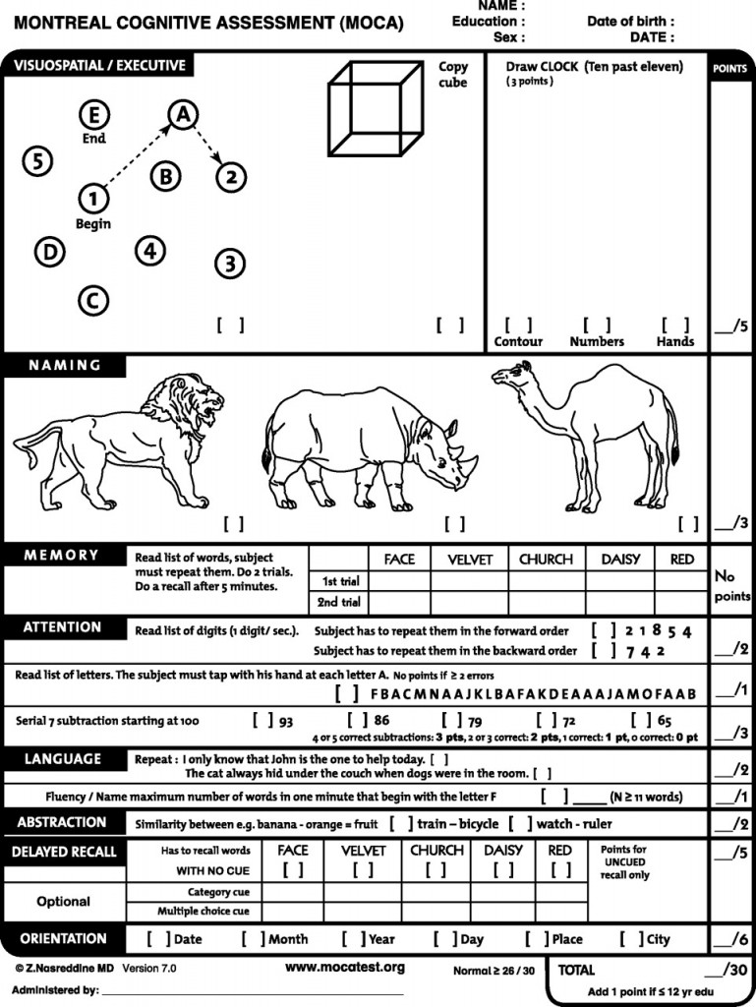
Cognition and visual perceptual Screens
Montreal Cognitive Assessment (MoCA)
Visual spatial
Attention
Language
Executive dysfunction
Memory
Notes:
Basic cognitive and visual perceptual assessment
No specialist training
Use to compare again norm population.
RCP)

Slide 44
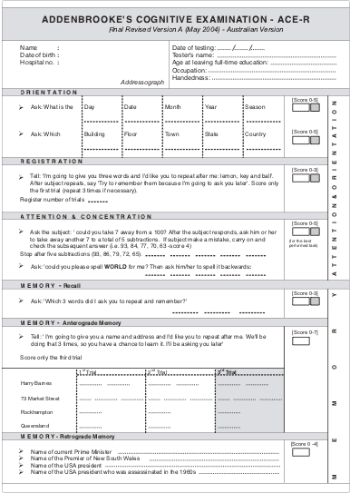
The ACE cognitive assessment refers to the Addenbrooke's Cognitive Examination (ACE-III), a 15-minute test used to screen for cognitive impairment, particularly dementia. It evaluates five cognitive domains: attention, memory, verbal fluency, language, and visuospatial abilities, with a higher score (out of 100) indicating better cognitive function

Slide 45
Cognitive observations
  Can they focus on your instruction?
  Can they concentrate over a long period or does their ability to listen/ follow what you say get more difficult over time
  Do they forgot to attend appointment or forget advice you have given
Do they have difficulty copying your instructions or using objects
Do they take a long time to follow your instruction.

Slide 46
Visual perception observations
Can they find objects at bed space?
What can patients see within the room?
Do they bump into items?
Recognise their bedside and find their way around the ward?
Can they describe how their body is organised?
Can they recognise an objects?
Difficulty judging distances- ie transferring from bed to chair?

Slide 47
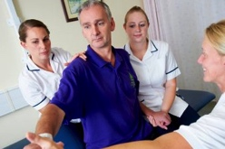
Case study- Mr B (PART B)
Reluctance to turn to the left hand side when walking
Overfilled a cup of water at the bedside.
Unable to find his way in familiar places when it is busy
Find its difficult to hold a conversation when it is busy.
Doesn’t always listen to instructions
What kind of cognitive and perceptual abilities do you think has be affected by the stroke?
Notes:
Your assessment and observe the following;

Slide 48
Cognitive and visual perceptual rehabilitation
4 principles:
Education; ‘drip feed’ approach; lots of repetition.
Process/impairment based; targeting specific impairments with exercises to overcome the problem.
Strategy/ compensatory; training to compensate for the problem.
Function; practice the skills learned in their everyday life.

Slide 49
Memory impairment- interventions in physiotherapy
Write down important information
Reinforcement and repetition
External aids – prompt sheets,
pictures
Consistency – location, tasks,
methods
Preparation – revisit before session, remind at end
Consider location for therapy
Create links to aid memory – e.g. diary
Ask family and MDT colleagues for
Strategies
Be aware of how this limits rehabilitation

Slide 50
Attention deficits- interventions in physiotherapy
Give instruction one step at a time
Reduce distractions
Grade complexity of tasks
Simple instructions
Identify limits of tolerance/fatigue
Timing of sessions

Slide 51
Speed of Processing: interventions in physiotherapy
Identify delay – count
Identify patterns – worse
with fatigue
Allow time for information
to be received/response- WAIT!
Simple instructions

Slide 52
Disorientation- Interventions in physiotherapy:
Consider environment for rehab, e.g. home vs hospital
Familiar items, people and places may help – use family
Consider MDT intervention, e.g. orientation boards
Re-orientate patient
State clear aims
Repetition of information
– consider format
Use environmental cues

Slide 53
Apraxia - Interventions in physiotherapy:
Consider context of object use
Task-specific training with strategies
Structure and familiarity
Hand-over-hand facilitation
Prevention of errors

Slide 54
Dysexecutive impairment- Interventions in physiotherapy:
External strategies – lists, prompt sheets, alarms, pictures
Give feedback
Prevent errors in performance

Slide 55
Insight- Intervention in Physiotherapy
Education
Reinforcement/repetition
Evaluation of performance,
pre- and post sessions

Slide 56
Visual and Spatial Perception
Assessment: observation, formal testing
Interventions in Physiotherapy:
Identify problem –
vision? depth?
Consider contrast in environment
Minimise obstacles
Practice and repetition
Liaise with MDT colleagues
Compensatory techniques

Slide 57
Neglect/Inattention- Intervention in Physiotherapy:
Observation; Do they bump into items, turn their head to affected side, can they find objects on affected side
Follow general MDT recommendations, eg. approach from affected side, increase stimuli on affected side
Reinforce scanning
Activities crossing midline
Shifting attention between left and right

Slide 58
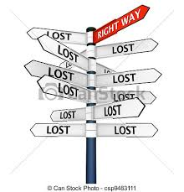
Topographical disorientation- Intervention in physiotherapy
Assessment
Observation
Repeat route finding? Any new learning?
Follow general MDT recommendations
Picking out and remembering key landmarks in the environment
Use signs – entries and exit signs.
Encouraging patient to vocalise directions

Slide 59
Agnosia- Intervention in Physiotherapy:
Observation; can the person recognise objects visually? By touch?
Education
Labelling
Hand patient objects required
Liaise with MDT colleagues for advice
Hand over hand facilitation
Use same objects, e.g. same ball, same frame

Slide 60
Key messages
Cognitive and visual perceptual impairments are common in most neurological conditions and will require physiotherapist to adapt your approach to rehab
Importance of observation and assessment
Importance of MDT working
Importance of understanding strategies to assist with rehab, note these may change if progressive in nature

Slide 61
References
Abreu, B., & Toglia, J. P. (1987). Cognitive rehabilitation: A model for occupational therapy. American Journal of Occupational Therapy, 41, 439-448
Blake et al (2002) An evaluation of screening measures for cognitive impairment after stroke. Age and ageing 31 (6):451-456
Cummings et al (2013) Stroke, cognitive deficit and rehabilitation: still an incomplete picture. International Journal of Stroke
Douiri et al (2012) Prevelence of post stroke cognitive impairment: South London Stroke register 1995-2010. Jan 44 (1):138-45
Hoffman et al (2010) Occupational therapy for cognitive impairment after stroke
Jackson, T., Wolff, S., Reid, L. and Edmans, J. (2010) Management of Cognitive and Perceptual Impairments. In Edmans, J. (Ed.) Occupational Therapy and Stroke Wiley-Blackwell, 144 – 173
MoCA http://www.mocatest.org
Neuroanatomy: http://www.dana.org/uploadedImages/Images/neuroanatomy_large.jpg
RCP (2012) National clinical guidelines for stroke. Forth Edition
Sohlberg, M.M. and Mateer, C.A. (1989). Theory and remediation of attention disorders. In M.M. Sohlberg and C.A. Mateer (Eds.) Introduction to Cognitive Rehabilitation New York: Guilford Press, 110 -135

